Slide 1
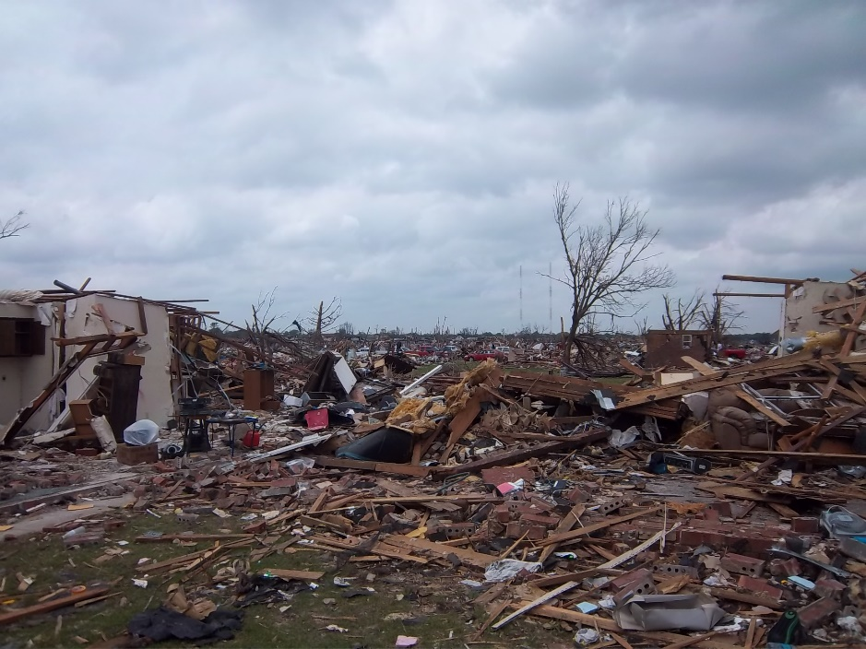
May 2013 Five Oklahoma counties were devastated by tornadoes.

Slide 2
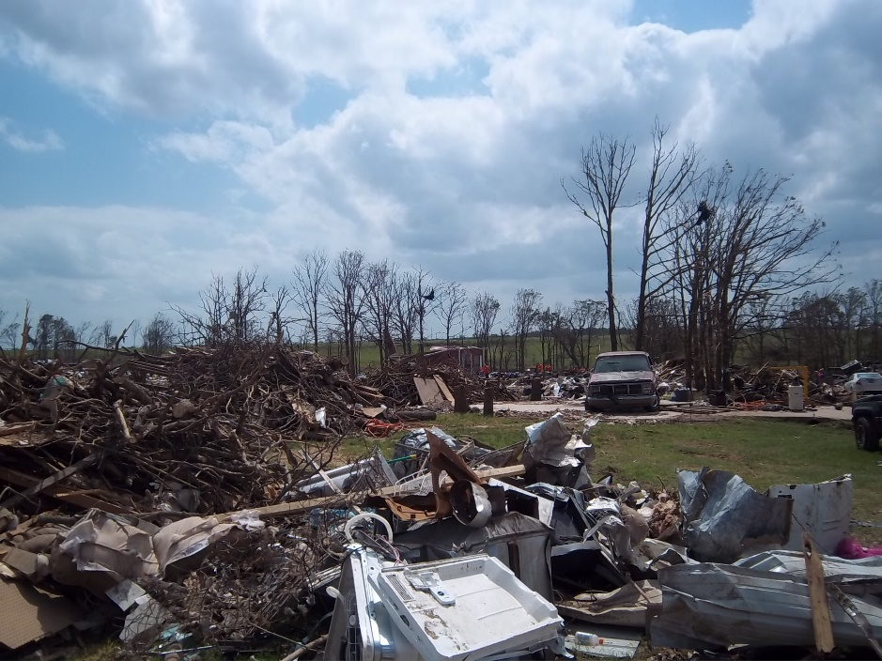

Slide 3
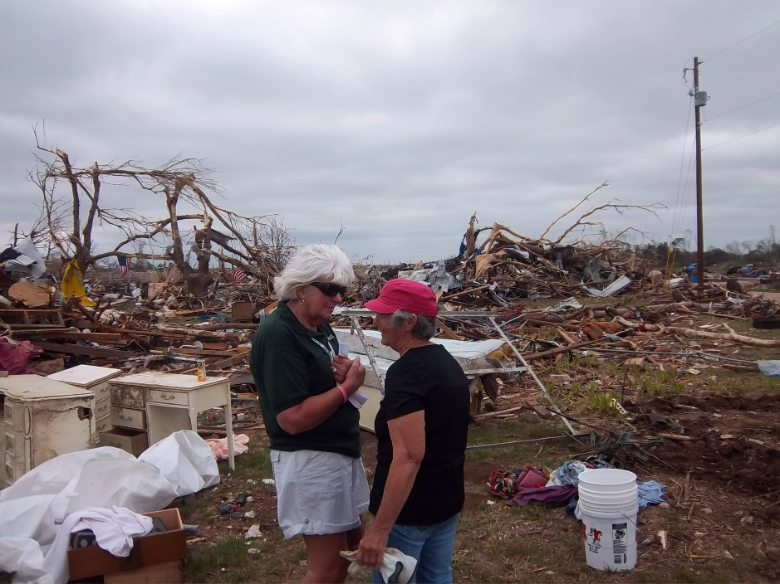

Slide 4
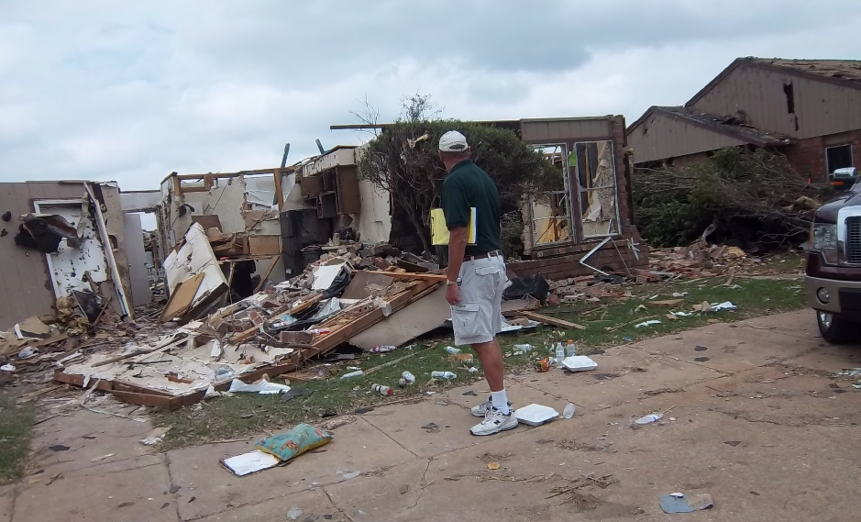
The tornado destroyed a block of duplex homes in Moore, Oklahoma.

Slide 5
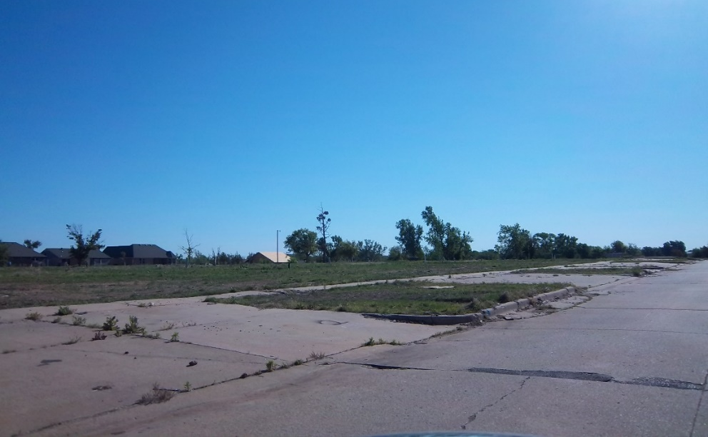
Today the land has been cleared, leaving only the cement driveways. Many homes have not been rebuilt.

Slide 6
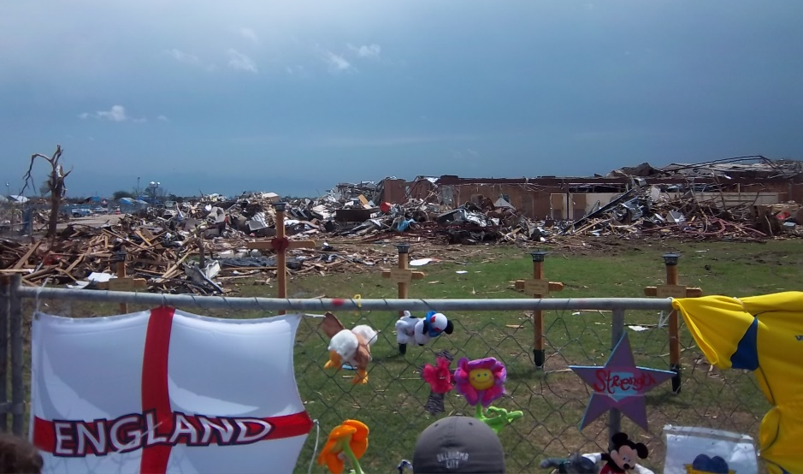
Plaza Tower School was destroy and tragically, seven children lost their lives. A memorial to the children was erected. Many volunteers traveled from all over the US and the world to help in the response. While here, they stopped to leave mementos of their love and respect.

Slide 7
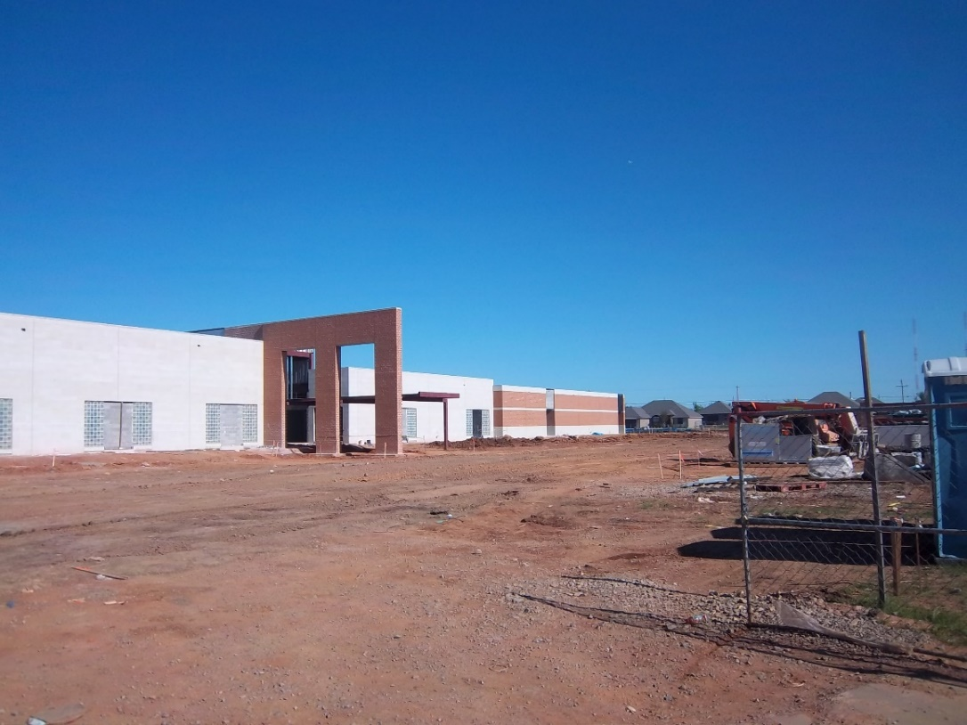
Today, local officials are rebuilding a larger school with a safe room . They are working seven days a week to complete the school for the 2014-2015 school year.

Slide 8
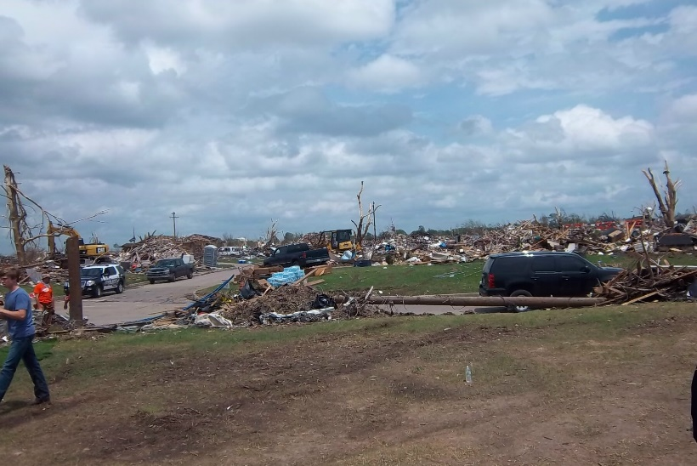
All of the homes in the neighborhood surrounding Plaza Tower School were leveled by the force of the tornado.

Slide 9
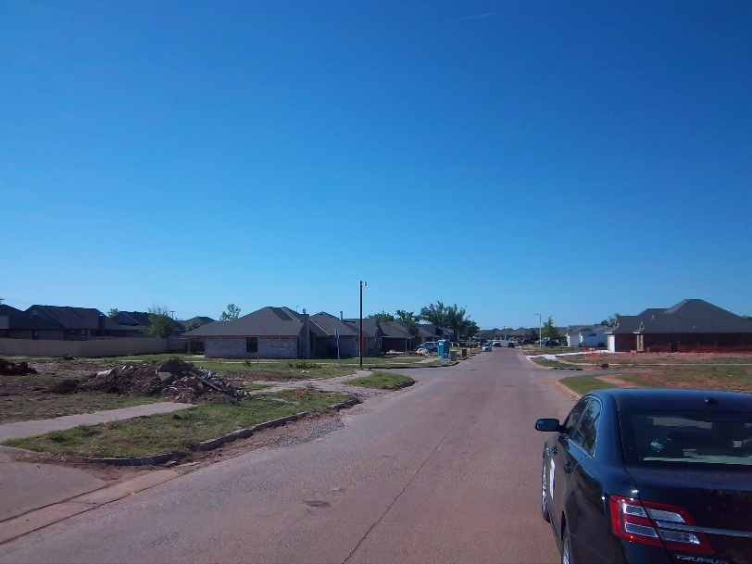
Most of the homes around the school are being rebuilt. One builder is constructing homes with 12” cement-exterior walls so the whole home will act as a safe room when a tornado strikes.

Slide 10
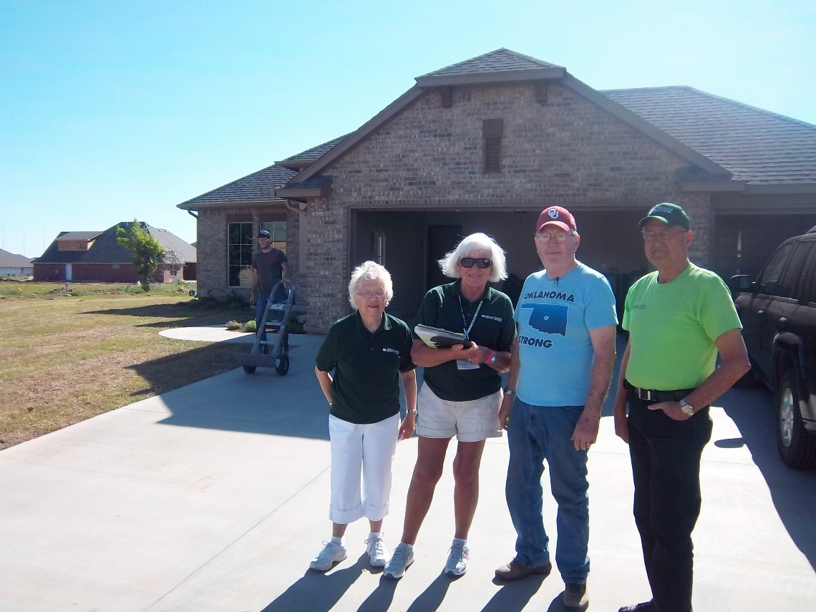
Jerry (blue shirt) moved into his new home two weeks before the one-year anniversary of the tornado. He is happy to be home, but every empty lot and cement slab where a home once stood reminds him of the day of the storm.
Notes:
Jerry Smith who was moving into his newly rebuilt home. He was so glad to be in, but also remarked on those empty lots and slabs where homes once stood are a reminder of the day of the storm. Jerry pointed to an empty lot just behind his home and told how a young mother and a grandmother had taken refuge in the bathroom of the home. They had gotten into the bath tub holding on to a 7 year old and a 9 month old daughter covering up with a mattress. The mother and grandmother were injured, but survived. The two girls were sucked out of the mother and grandmother arms. The body of the 7 year old was found that same day, and the body 9 month old baby was not found until the next morning in the shrubbery near the home.

Slide 11
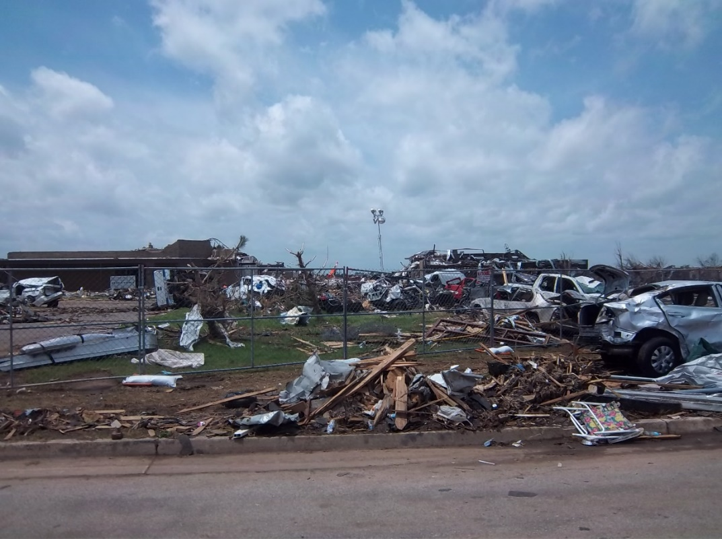
Briarwood School was also heavily damaged and had to be completely torn down after the disaster.

Slide 12
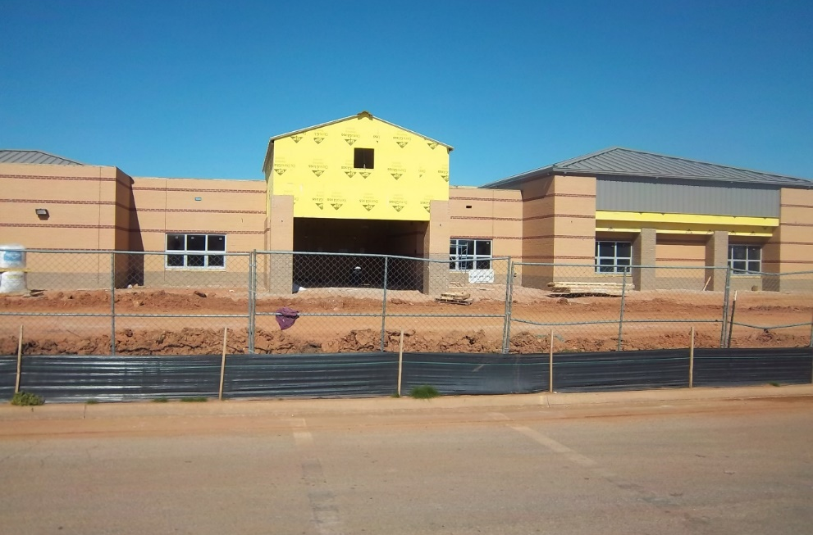
Today, Briarwood School is on the same building schedule as Plaza Tower School and will be completed for the 2014 – 2015 school year.

Slide 13
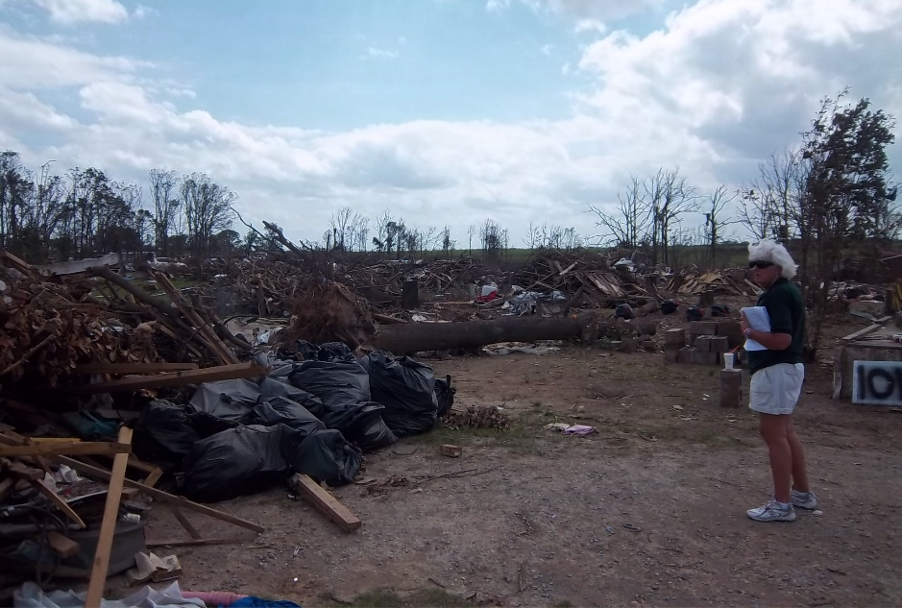
Steelman Estates in Pottawatomie County is a mobile home park that was hit hard, destroying most the homes in the park.

Slide 14
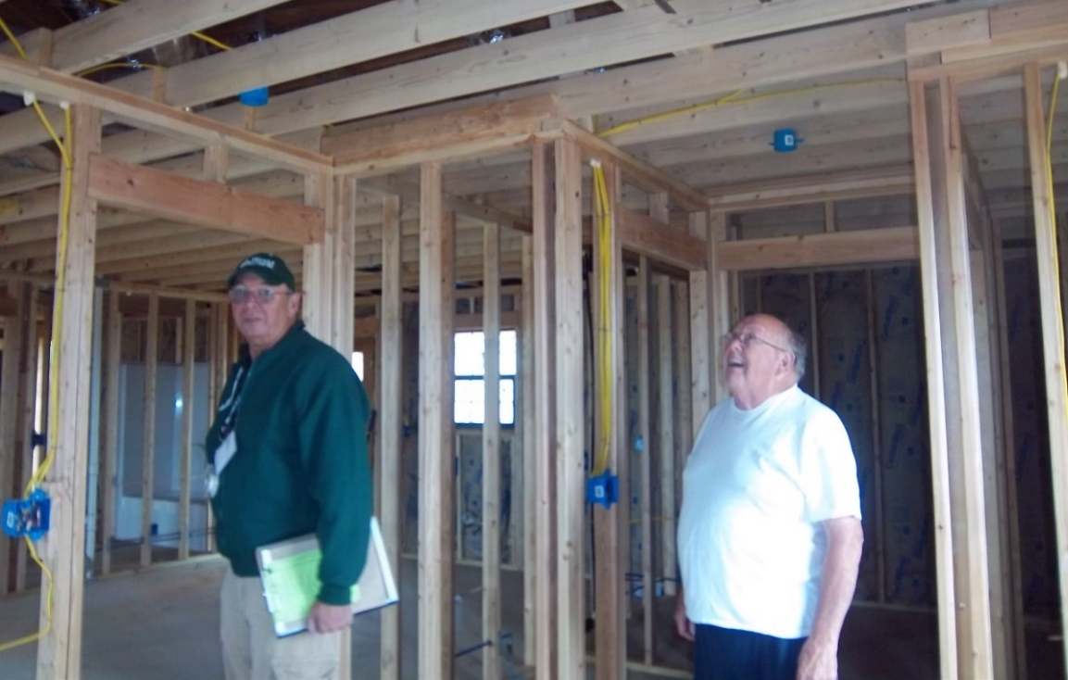
Most homeowners are returning to this area. Resident Tom Cox is grateful for volunteer labor from the community and donated supplies that are making the reconstruction of his home possible.

Slide 15
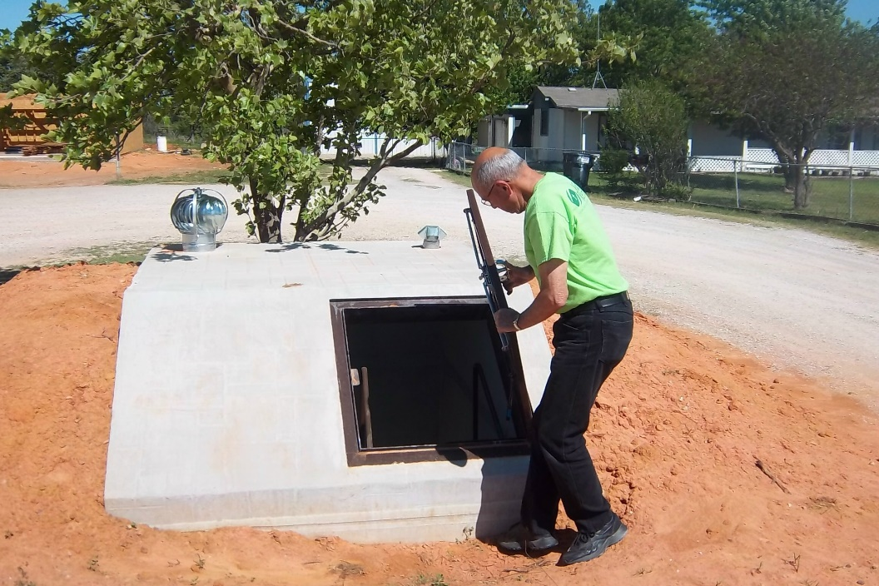
One of the many new storm shelters in Pottawatomie County. A 30-person safe room was also donated and erected in a community park.

Slide 16
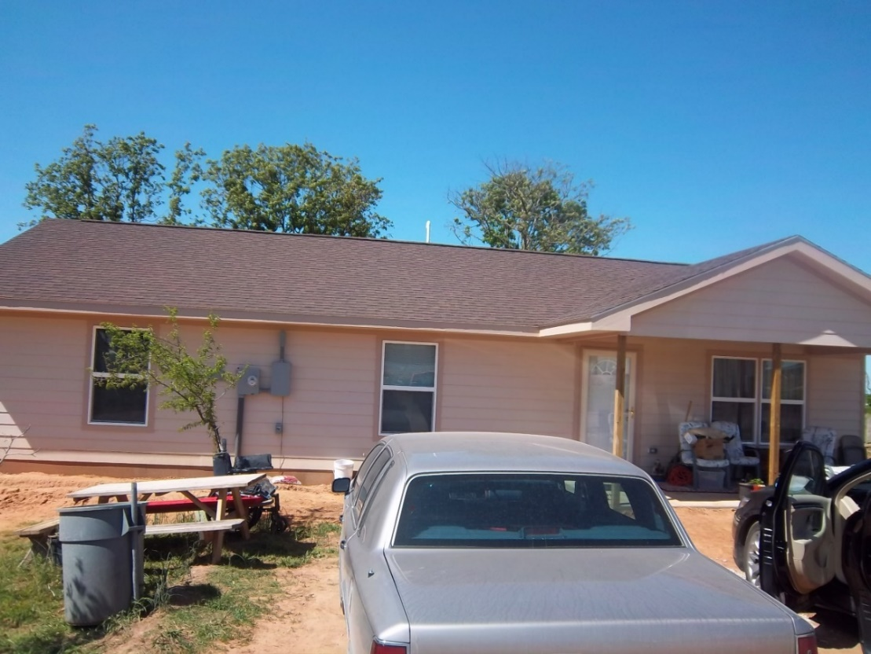
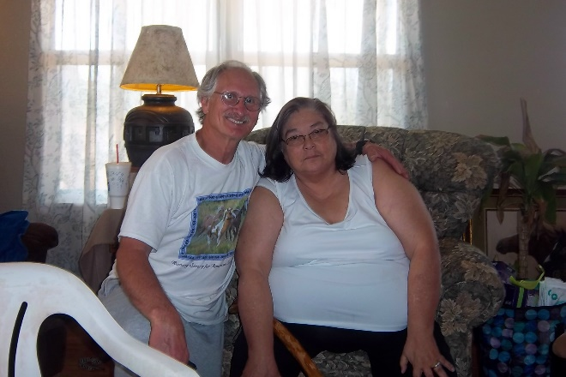
Steve and Janice Folch’s home was built by volunteers. They were able to return home in April 2014. They give all glory to God for providing this home for them and their disabled adult son, Richard.

Slide 17
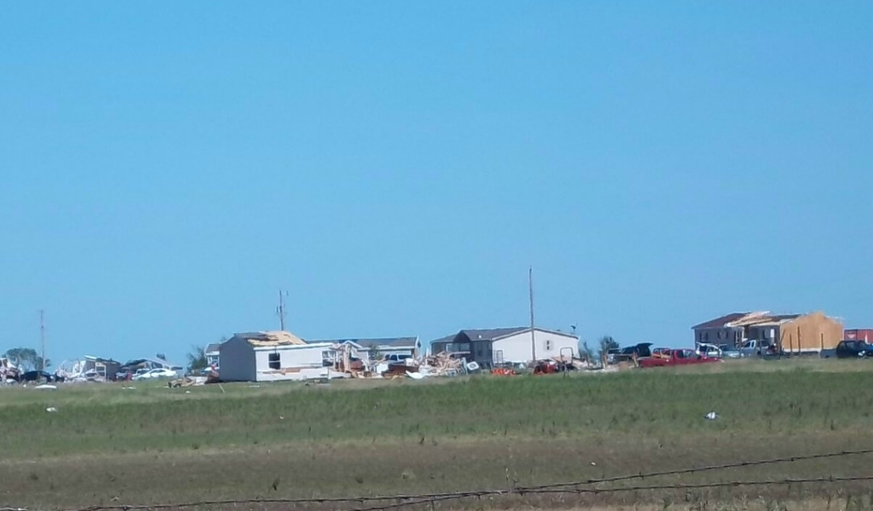
This mobile home park just outside of El Reno was destroyed on May 31, 2013, by an E5 tornado that cut a swath 2.5 miles wide.

Slide 18
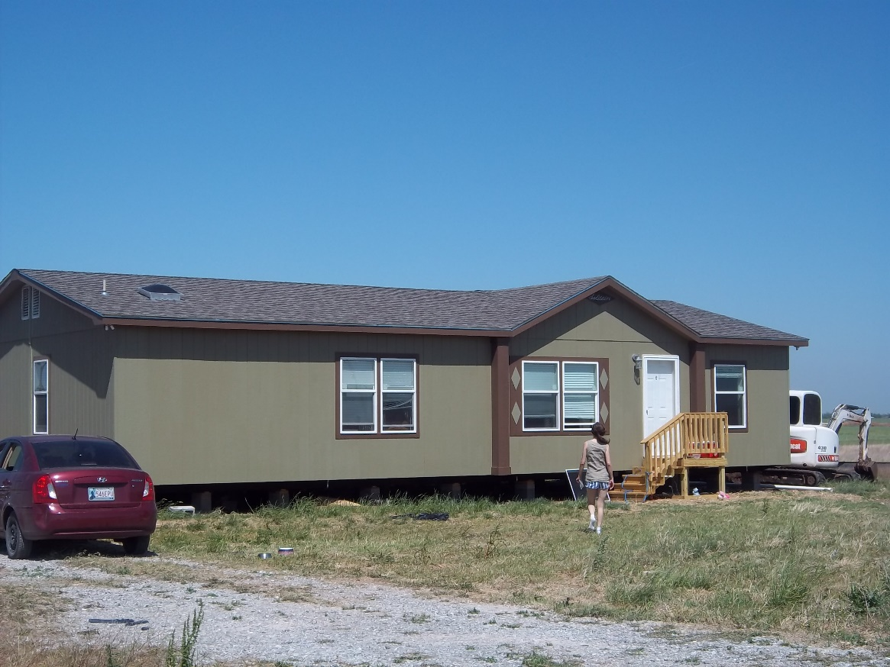
Sherry Nusz was glad to move into her new home on May 5, 2014, after living in a motel for almost a year since the tornado destroyed her former home.

Slide 19
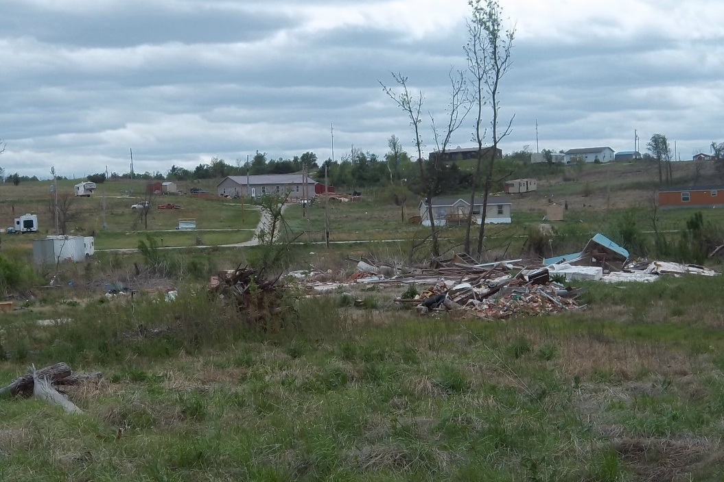
However, there are homes that remain untouched and families who are unable to recover without help.

Slide 20
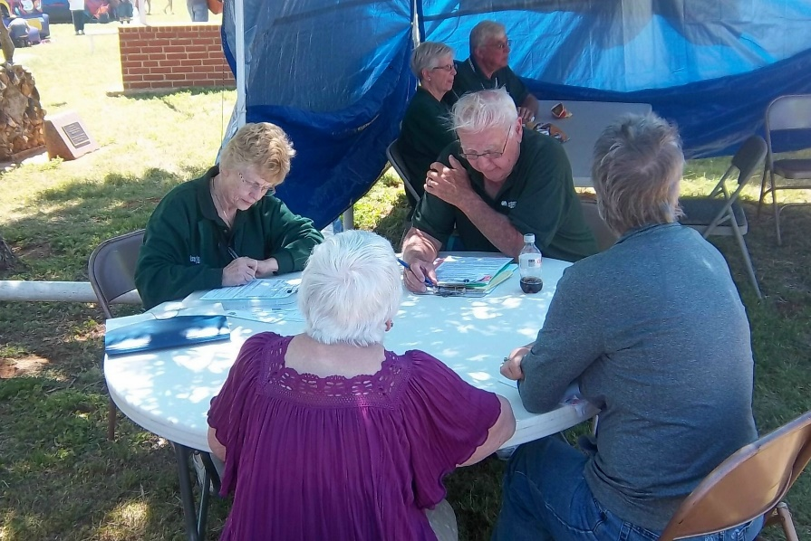
In May 2014, World Renew DRS conducted an Unmet Needs Assessment with residents in five Oklahoma counties, identifying 300 homeowners who are still in need of help, including those who are elderly or disabled. .

Slide 21
World Renew continues to be involved in the long-term recovery process in Oklahoma one year after the
May 2013 tornadoes struck.
There are many homeowners who still need assistance.
Thank you for your prayers and donations that make this ongoing work possible!
worldrenew.net/drs

