Slide 1
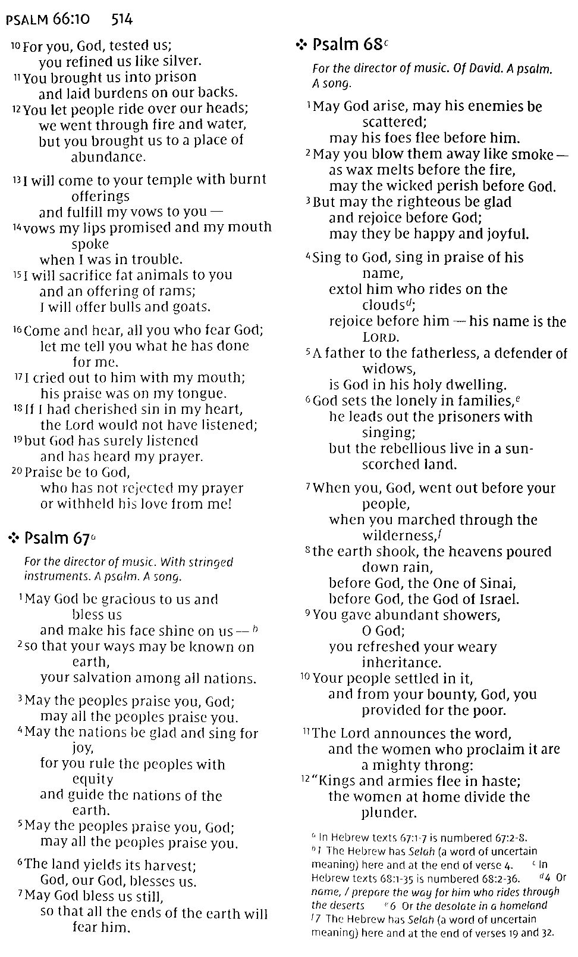
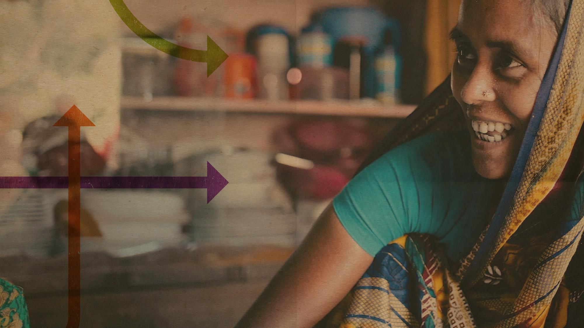
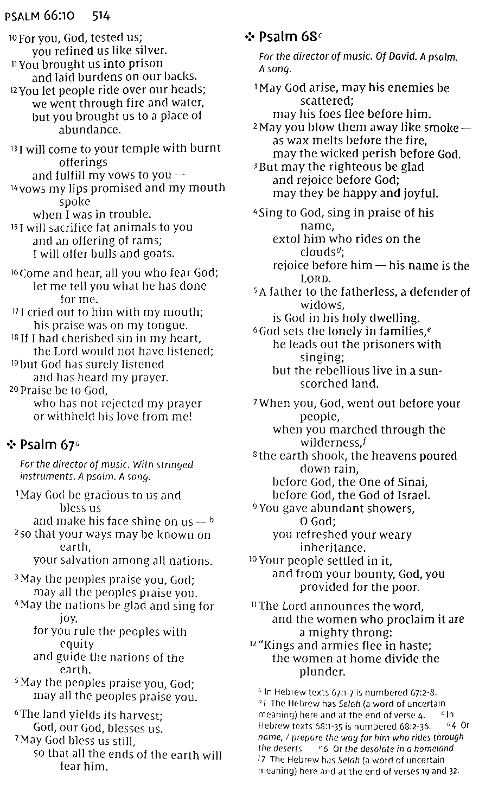
BUILDING
PATHWAYS
OUT OF
POVERTY

Slide 2

BUILDING PATHWAYS OUT OF POVERTY
The world needs love, faith, and hope now more than ever. Compelled by God’s deep passion for justice & mercy, World Renew joins communities around the world to renew hope, reconcile lives, and restore creation.

Slide 3

BUILDING PATHWAYS OUT OF POVERTY
World Renew embraces a family-centered approach to ending global poverty with food security, peace and justice, economic development, and health.
We join families in more than 30 developing countries to change global hunger, poverty, and illness.

Slide 4
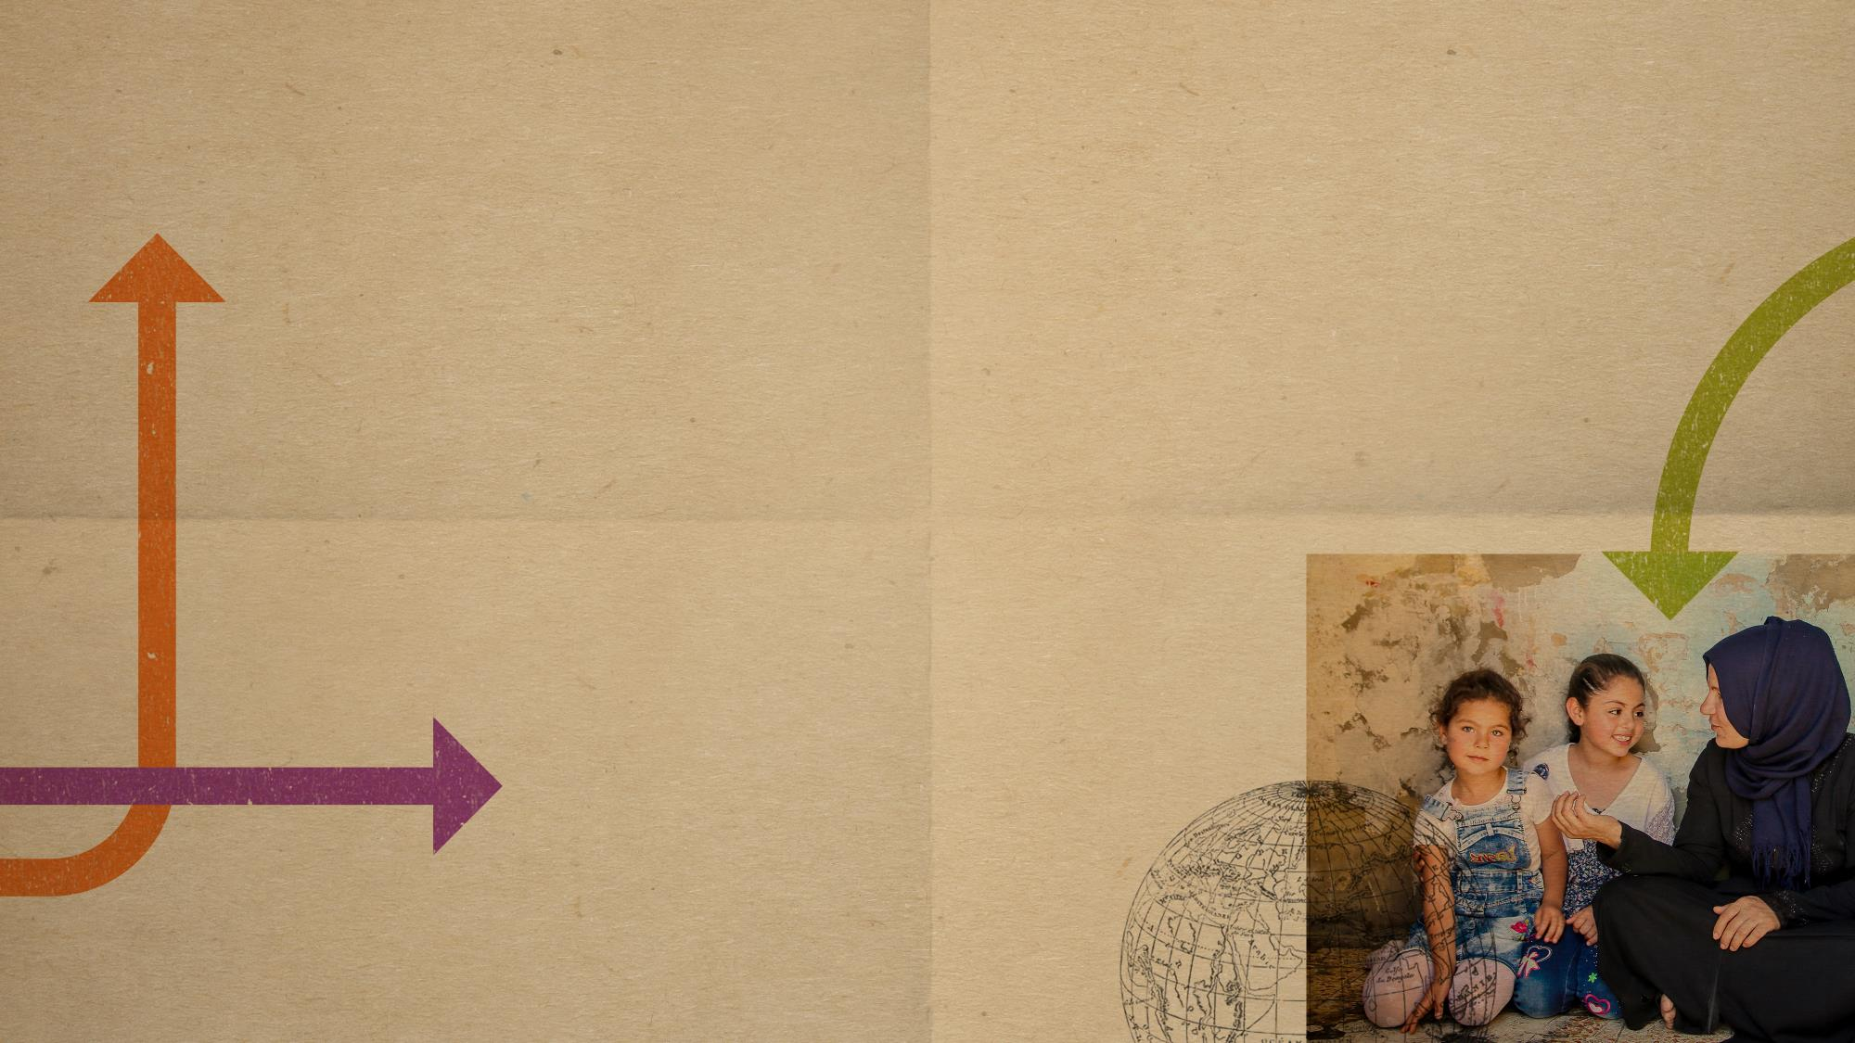
QUESTION
HOW MANY PEOPLE DID
WORLD RENEW
MINISTER TO IN 2020?
Family of Syrian Refugees
Lebanon

Slide 5

ANSWER
1.4 MILLION
PEOPLE
IN 35 DIFFERENT COUNTRIES

Slide 6

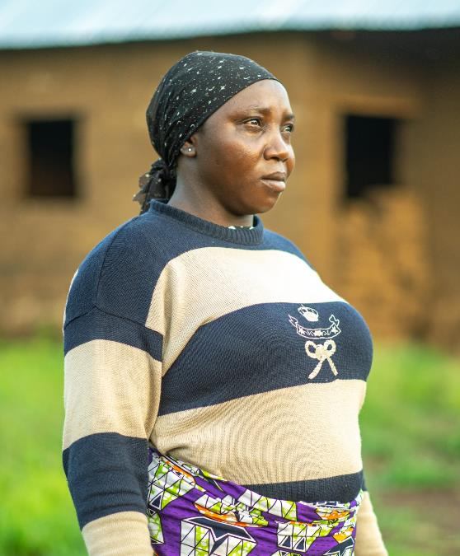
QUESTION
HOW MUCH SAVINGS DID NIGERIAN FAMILIES GAINED AS A RESULT OF A
VSLA?
(VILLAGE SAVINGS
& LOAN ASSOCIATION)
Nvou Gyang
Mother

Slide 7
ANSWER
$36,293 CAD
IN PERSONAL SAVINGS
OVER THE LAST 3 YEARS

Slide 8
ANSWER
$28,765 USD
IN PERSONAL SAVINGS
OVER THE LAST 3 YEARS

Slide 9
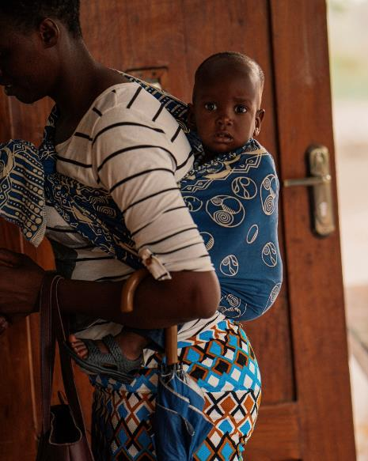
QUESTION
HOW MANY CHILDREN IN ZAMBIA EXPERIENCE COGNITIVE, PHYSICAL & SOCIAL
IMPAIRMENTS DUE TO LACK OF
FOOD?
Zambia
Drought Response

Slide 10
ANSWER
1 IN 3
CHILDREN

Slide 11
QUESTION
HOW MANY PARENTS IN BANGLADESH
HAVE MADE A COMMITMENT TO NOT
ENGAGE IN CHILDHOOD
MARRIAGE
FOR THEIR DAUGHTERS?

Slide 12
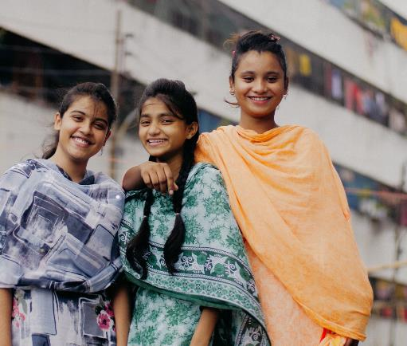
ANSWER
3,765
PARENTS
Fajima & Friends
Bangladesh

Slide 13
QUESTION
WHERE HAS WORLD RENEW TRAINED
4,000
FAMILIES
IN SUSTAINABLE FARMING TECHNIQUES?

Slide 14
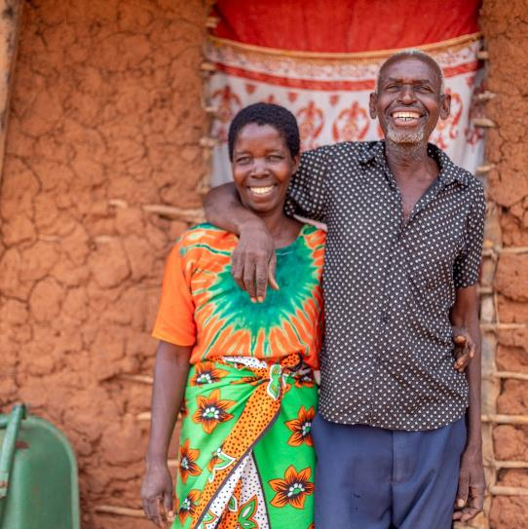
ANSWER
KENYA
Kazitu & Alfred
Kenya

Slide 15
QUESTION
HOW MUCH DOES IT TAKE TO
EQUIP A FAMILY TO
CHANGE
THE STORY OF POVERTY & HUNGER?

Slide 16
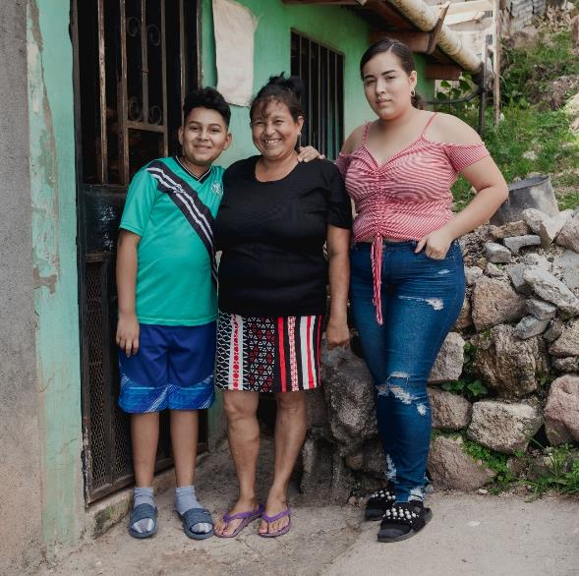
ANSWER
$27
A MONTH
Merlyn and Family
Free a Family Participants

Slide 17
QUESTION
IN 2020, HOW MUCH FOOD DID WE
DELIVER TO FAMILIES EXPERIENCING
HUNGER BECAUSE OF
COVID-19?

Slide 18
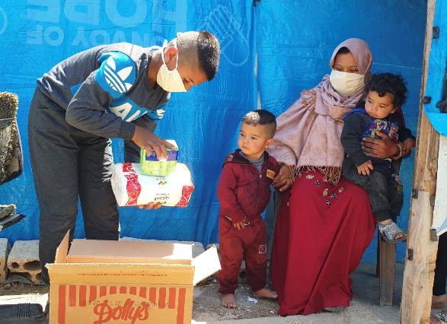
ANSWER
80,693
POUNDS
OF FOOD
Family of Syrian Refugees
Lebanon

Slide 19
QUESTION
IN 1 YEAR, HOW MANY HOUSEHOLDS WORKING
WITH WORLD RENEW IN KENYA TREATED
THEIR DRINKING
WATER
FOR CLEAN AND SAFE USE?

Slide 20
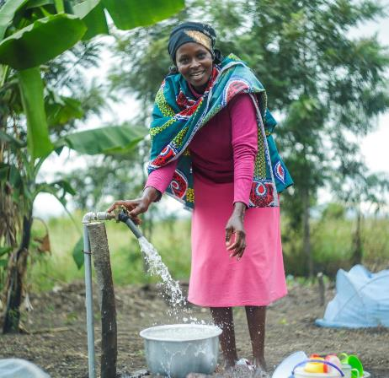
ANSWER
1,500
HOUSEHOLDS
Community Member
Kenya

Slide 21
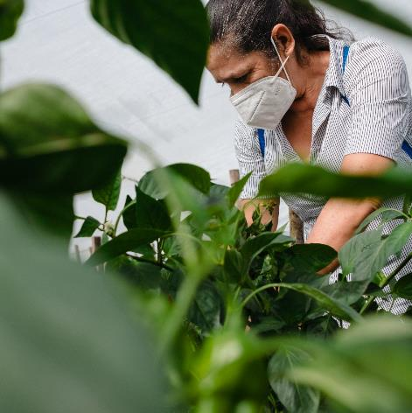
QUESTION
HOW MANY PEOPLE MADE GAINS IN
ACHIEVING LONG-TERM FOOD SECURITY
2021
THROUGH WORLD RENEW?
Farmer
Honduras

Slide 22
ANSWER
154,167
PEOPLE

Slide 23
QUESTION
HOW MANY TREES HAS WORLD RENEW
PLANTED IN
HAITI
TO IMPROVE FARMING AND
LOCAL SOIL CONDITIONS?

Slide 24
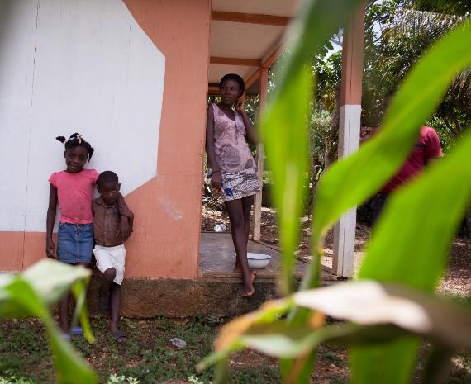
ANSWER
500
TREES
Delice Family
Haiti

Slide 25
QUESTION
WHAT PERCENTAGE OF FARMERS IN
THE CENTRAL RIFT REGION OF KENYA WORKING
WITH WORLD RENEW INCREASED THEIR
FOOD
PRODUCTION IN 2018 to 2019?

Slide 26
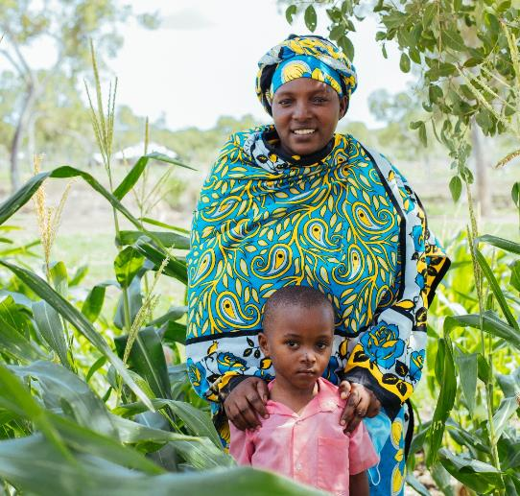
ANSWER
100%
OF FARMERS
Happy & her son
Kenya

Slide 27
QUESTION
WHERE DOES WORLD RENEW DISTRIBUTE
FOOD BASKETS & FOOD VOUCHERS TO OVER
12,000
FAMILIES?

Slide 28
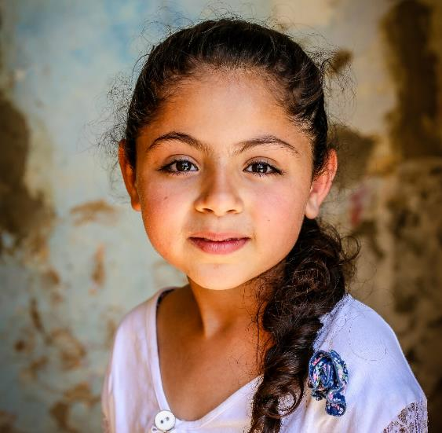
ANSWER
LEBANON
& SYRIA
Young Syrian Refugee
Lebanon

Slide 29
QUESTION
FROM 2016-2019, WHAT INCREASE
DID WORLD RENEW SEE IN
ZAMBIA
AMONG BABIES IN OUR
HEALTH PROGRAMS?

Slide 30
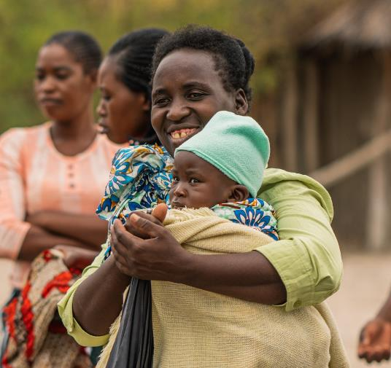
ANSWER
178%
INCREASE IN BABIES
EXPERIENCING
HEALTHY DEVELOPMENT
Mother & baby
Zambia

Slide 31
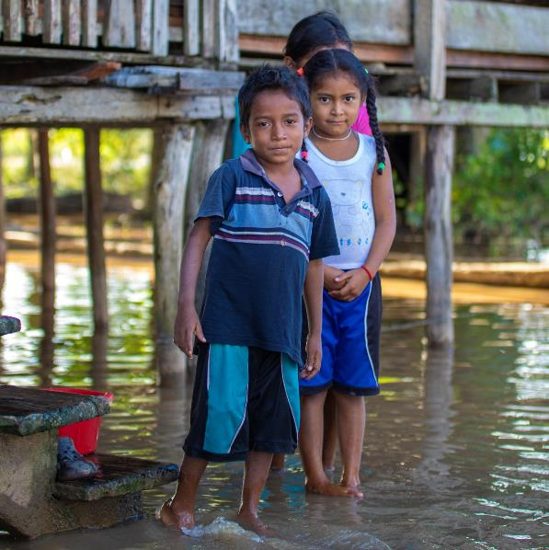
QUESTION
HOW MANY PEOPLE DID WORLD RENEW
IDR
ASSIST IN 2021 DURING
CONFLICTS, NATURAL
DISASTERS & COVID-19?
DRS Volunteer
US & Canada
Hurricane Survivors
Nicaragua

Slide 32
ANSWER
865,000
PEOPLE
IN 26 COUNTRIES IN 2021

Slide 33
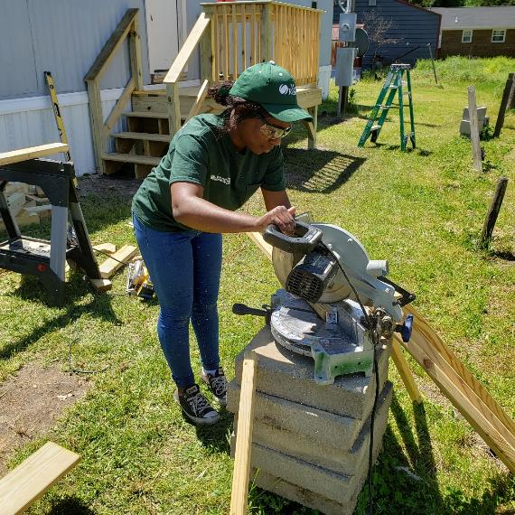
QUESTION
HOW MANY PEOPLE HAS WORLD RENEW
DRS
HELP RECOVER FROM
HURRICANES, FLOODS,
WILDFIRES & TORNADOES?
DRS Volunteer
US & Canada

Slide 34
ANSWER
OVER 175,000
PEOPLE
IN THE US & CANADA

Slide 35

VISIT
PathwaysOutofPoverty.com
PathwaysOutofPoverty.ca

Slide 36
